Slide 1
SALES DATASET ANALYSIS – ADVANCED EXCEL PROJECT
KISHORE VASUDEVAN
17/03/2025
DATA ANALYTICS & DATA SCIENCE
FEB 25’

Slide 2
PROJECT OVERVIEW & OBJECTIVES
The Superstores Sales Dataset contains 9,994 records and 21 columns, capturing details about sales transactions, including order details, customer information, product categories, and financial metrics. The dataset spans multiple years and regions, offering insights into business performance.
Project Objectives :
Sales Analysis: Identify trends in total sales, best-selling products, and revenue distribution across categories.
Customer Insights: Analyze customer segments and regional demand.
Profitability Analysis: Assess profit margins, discount impacts, and product performance.
Time Series Trends: Evaluate sales growth over time, peak seasons, and yearly performance.
Operational Efficiency: Examine shipping modes, delivery times, and their influence on sales.

Slide 3
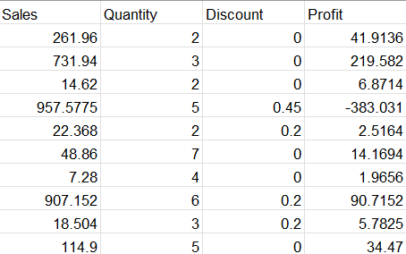
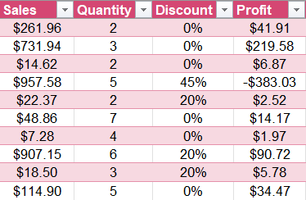
DATA DESCRIPTION AND PREPARATION
Dataset Overview :
Superstore dataset has around 9994 Rows and 21 columns.
Data Cleaning Process :
Use power query for data type transformation and to find if any error occurs like blank cells.
Remove duplicate by using concatenation in excel or we can use “Remove Duplicate” option.
And presented data into a table format for readability.
Visuals :
Before Clean After Clean

Slide 4
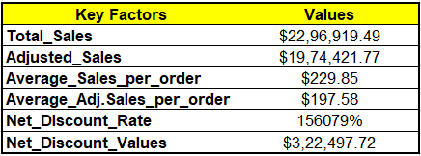
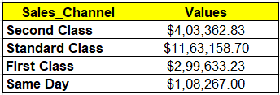
Key Metrics Calculation and Data Analysis
Key factors for dataset :
Formulas :
Total Sales = SUM(Superstores_sales_dataset4[Sales])
Adjusted_Sales =SUM(Superstores_sales_dataset4[Adjusted_Sales])
Average_Sales_per_order =AVERAGE(Superstores_sales_dataset4[Sales])
Average Adj Sales per order =AVERAGE(Superstores_sales_dataset4[Adjusted_Sales])
Net Discount Rate =SUM(Superstores_sales_dataset4[Discount])
Net Discount Values =SUM(Superstores_sales_dataset4[Discount_Value])
Sales Channel =SUMIF(Superstores_sales_dataset4[Ship_Mode],'Segment '!D17,
Superstores_sales_dataset4[Adjusted_Sales])

Slide 5
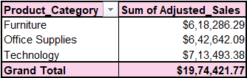
Pivot Tables and Pivot Charts
Pivot table is a functionality in Excel which helps you organize and analyze data in aggregated manner.
By using Insert > Pivot Table.
Pivot field section opens, in that select and drag the Ship_Mode in Rows and Adj_Sales in Values by follows same for Product type or Date.
Pivot Chart Visualizations :

Slide 6
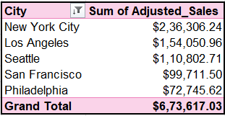
Pivot Table & Chart Visual

Slide 7
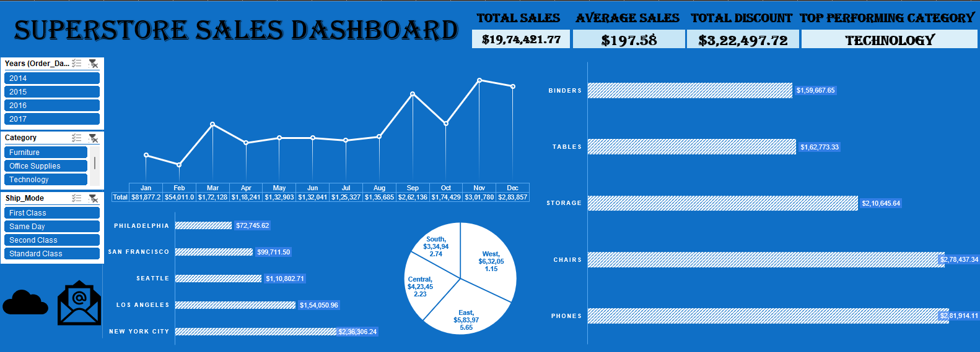
Dashboard Overview
Dashboard Design :
An interactive dashboard displays key metrics like Total Sales, Average Values, and Top Performers. Slicers help filter data and visualize results in charts.
Visual :

Slide 8
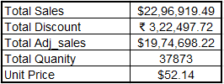
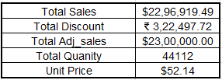
What-If Analysis & Goal Seek
What-If Analysis is the process of changing the values in cells to see how those changes will affect the outcome of formulas on the worksheet
Goal Seek :
Below Goal seek, performs how to achieve a $23,00,000 revenue by changing total quantity.
Before After

Slide 9
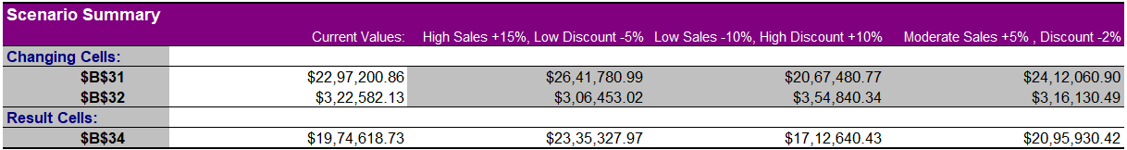
What-If Analysis – Scenario Manager
Create this go to Data > What-If-Analysis > Scenario Manager.
Below performs with some various sales increased and decreased discount and vice versa.

Slide 10
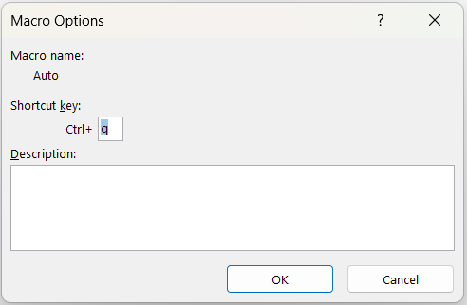
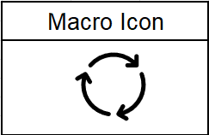
Macros and Automation
Use this go to Developer > Record Macro.
Name the macro "AUTO", assign the shortcut key CTRL+Q, and start recording. After completing all actions, go to Developer > Stop Macro.
By using macro help to save time for regular tasks.
In this Macro, it performs freeze the pane, bold the header, center the data, change the data type, categories with product category and also create a pivot table.
By using the icon, we can perform the macro.

Slide 11
Insights and Recommendations
Standard class has performed well by gross margin of $11,3,158.70.
Top performing category is Technology with value of $7,13,493.38 by sales.
Seasonal Sales has occurred at every end of the year mostly falls on November with good sales value.
By product category, Technology has the highest sales value of $7,13,493.38, despite an average discount rate of 13%. In contrast, Furniture has the lowest sales at $6,18,286.29, with a higher average discount rate of 17%. Since Furniture sales are lower despite the higher discount, I recommend slightly increasing discounts for Technology and moderately adjusting them for Furniture to optimize overall profit.

Slide 12
Conclusion
By analyzing the dataset, we observe an upward sales trend, with sales reaching $6,31,962.67 (Adj. Sales) in 2017.
The Technology category has consistently performed well each year, making it the ideal space to introduce new products and strengthen market position especially in East & West.
Next Step :
Every year, the last quarter shows strong sales margins. In the future, analyzing holiday-specific sales data may help boost periodic sales.
Future data should be generated with high accuracy while ensuring duplicate values are eliminated.
Year | Sum of Adjusted_Sales
2017 | $6,31,962.67
2016 | $5,28,294.03
2015 | $4,07,671.32
2014 | $4,06,493.74
Grand Total | $19,74,421.77

Slide 13
Questions Are Welcome!!!

